Slide 1
Machine Learning Fundamentals Capstone Project - Presentation
for Codecademy Course – by Santhosh P Mathew

Slide 2
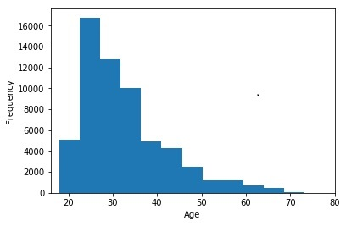
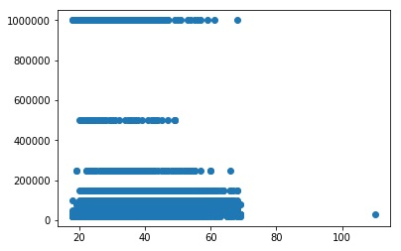
Exploration of datasets
Age data - histogram
Income data – scatter plot

Slide 3
Questions used
Regression
Can we predict income value based on the following multiple features?
age, education level, job level and status of drinking, smoking, and drugs intake.
Can we predict age based on income?
Classification
Can we predict level of education (3 levels) based on the following features?
job level and status of drinking, smoking and drugs intake

Slide 4
Two new columns created – drinks_code, education_code ( other columns like job_code, smokes_code, drugs_code were also created ) – numerical values are created and the same is mapped to categorical data.
drinks_code
df.drinks_code.head()
0 2.0
1 3.0
2 2.0
3 2.0
4 2.0
Name: drinks_code,
dtype: float64
education_code
df.education_code.head()
0 3.0
1 3.0
2 3.0
3 3.0
4 1.0
Name: education_code,
dtype: float64

Slide 5
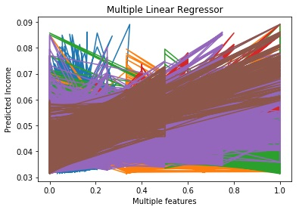
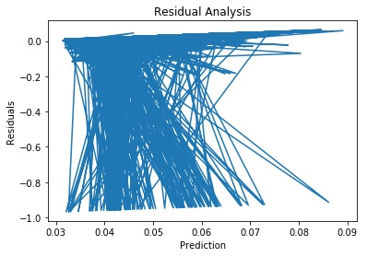
Multiple Linear Regression
MLR was used to predict income from multiple features . The following data frame was created:
x = df[['age','education_code','job_code','drinks_code','smokes_code','drugs_code']]
This was trained, generalized and tested. Model fitting time was 15.6ms and MAE was 0.0269

Slide 6
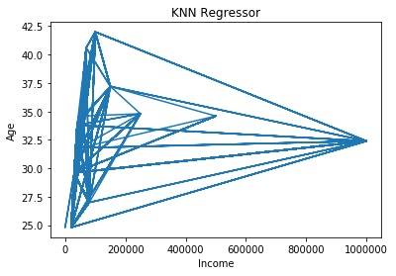
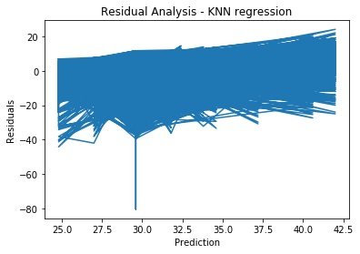
KNN Regressor
Predicted age from income – model fitting took almost no time since this is a linear regression. MAE = 6.9053. Residual Analysis is also given below.

Slide 7
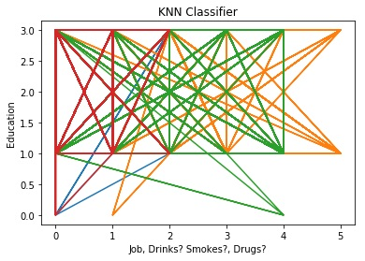
KNN Classifier
Education levels were predicted based on job level and status of drinking, smoking and drugs intake. Model fitting took 9.85s and accuracy of 0.530903328 was obtained.

Slide 8
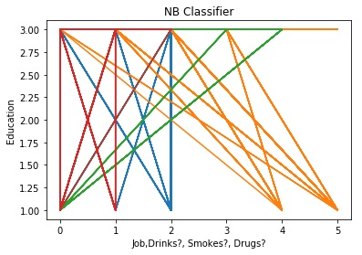
Naive Bayes Classifier
Education levels were predicted based on job level and status of drinking, smoking and drugs intake. Model fitting took 15.6ms and accuracy of 0.55542580698 was obtained.

Slide 9
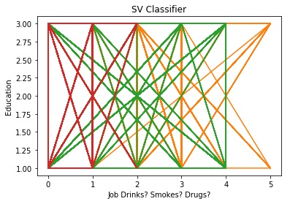
Support Vector Classifier
Education levels were predicted based on job level and status of drinking, smoking and drugs intake. Model fitting took 46.5s and accuracy of 0.56743681708 was obtained.

Slide 10
Conclusions
Can we predict income value based on the following multiple features?
We predicted income from multiple features using Multiple Linear Regression
Can we predict age based on income?
Age was predicted from income using KNN Regression (normal Linear Regression was also tried)
Can we predict level of education levels based on multiple features?
We predicted education level based on job level, status of drinking, smoking and drugs intake using KNN Classifier, NB Classifier and SV Classifier.
There were many null values in the profiles.csv files. I had to fill them with specific values and this has created an imbalance in the data (eg: ‘income’ )and prediction results have adversely been affected by this. I feel it is important that we train the model with correct data to get better results.

